Slide 1
Lecture 10
Variance
Property of Variances
The variances of Bernoulli, Binomial and Poisson Distributions
The Exponential Distribution

Slide 2
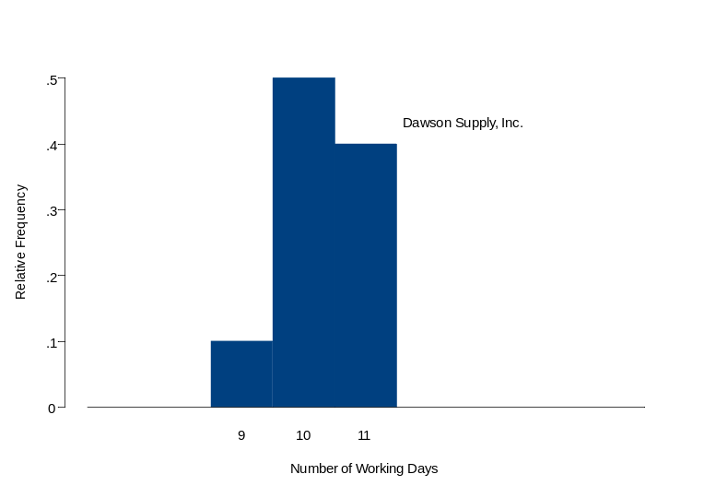
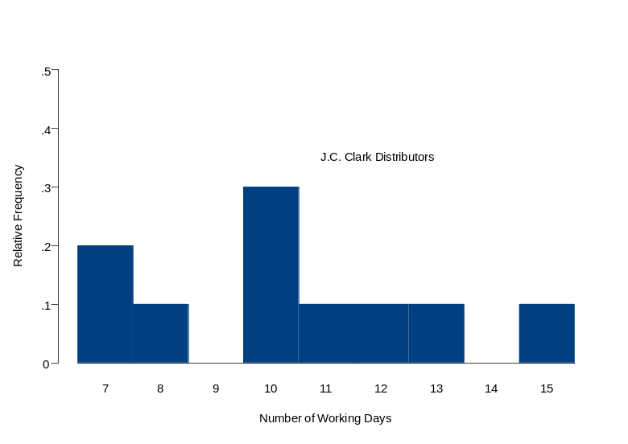
Variance is Dispersion
Why do we need it?
  e.g. The number of working days required to fill orders from two suppliers.
Mean=10.3
Which one would you choose?

Slide 3
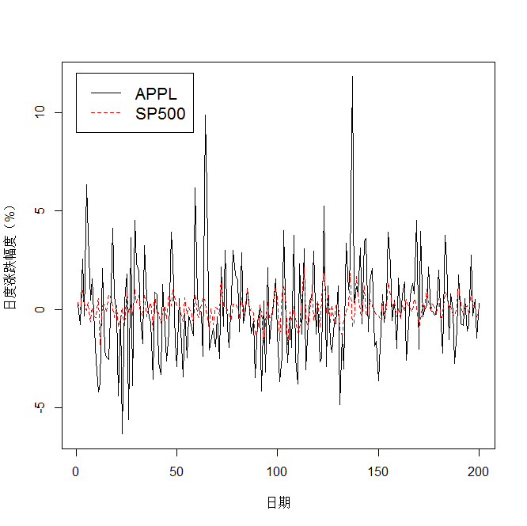
Variance is Risk

Slide 4
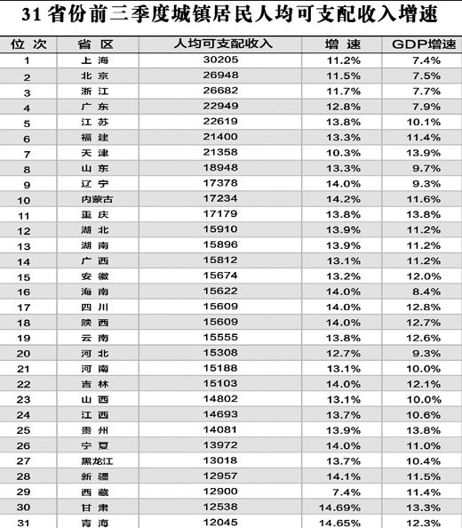
Variance is Income Disparity

Slide 5



The variance is the average of the squared deviations (the difference between data value and the mean). Formally, suppose X has mean . The variance of X, is defined as:
  It follows that
  If the possible values of X are bounded, then Var(X) must exist.
  The variance provides a measure of the spread or dispersion of the distribution around its mean.
  The variance can be affected greatly by extreme values.

Slide 6


  The standard deviation is defined to be the nonnegative square root of the variance.
  Generally, the standard deviation of a given random variable is denoted by , and the variance is denoted by .

Slide 7
Properties of Variance
Theorem. Var(X)=0 if and only if there exists a constant c such that Pr(X=c)=1.

Slide 8

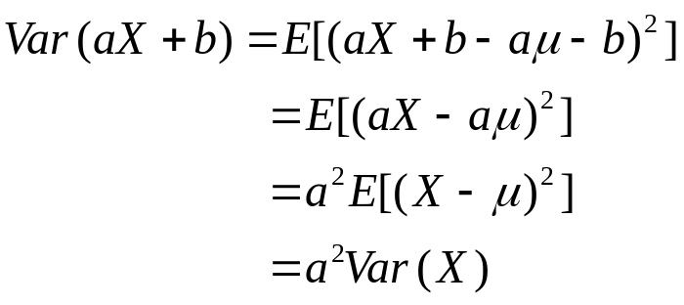
Theorem. For any constants a and b,
Proof. If E(X)=μ, then E(aX+b)=aμ+b. So
Note: Var(X+b)=Var(X)
Var(-X)=Var(X)

Slide 9

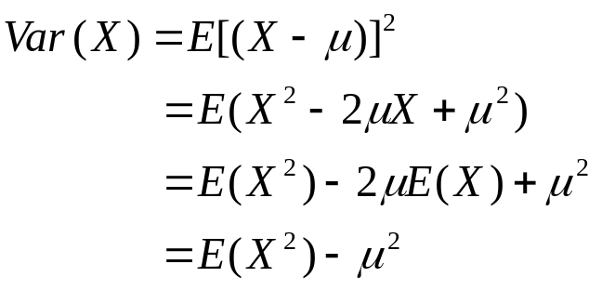
Theorem. For any random variable X,
Proof. Let E(X)=μ. Then

Slide 10
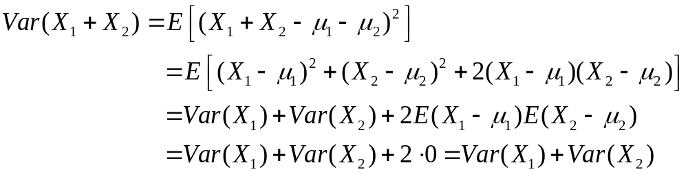
Theorem. If X1,...,Xn are independent random variables, then
Var(X1+...+Xn)=Var(X1)+...+Var(Xn).
Proof. Suppose first n=2. If E(X1)=μ1, E(X2)=μ2
then E(X1+X2)= μ1+μ2
So
The theorem can be established for any positive number n by an induction argument.

Slide 11
Corollary. If X1,...,Xn are independent random variables and if a1,...,an and b are arbitrary constants, then

Slide 12




Example
Suppose X can take each of the five values –2, 0, 1, 3, and 4 with equal probability. What is the standard deviation of Y=4X-7?
  E(X)=1/5(-2+0+1+3+4)=1.2
  E( )=
  Var(X)= =4.56
  Var(Y)=16Var(X)=72.96
  The standard deviation of Y is

Slide 13
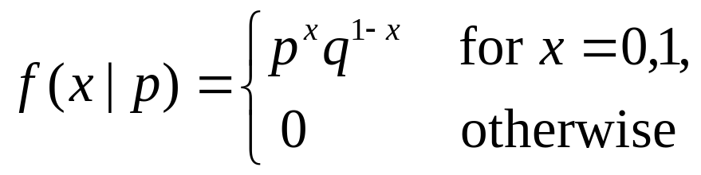
Variance of The Bernoulli Distribution
A random variable X has a Bernoulli distribution with parameter p if X can take only the values 0 and 1 with probabilities:
  Pr(X=1)=p and Pr(X=0)=q=1-p.
The p.f. of X can be written as:
E(X)=p
Var(X)=pq

Slide 14
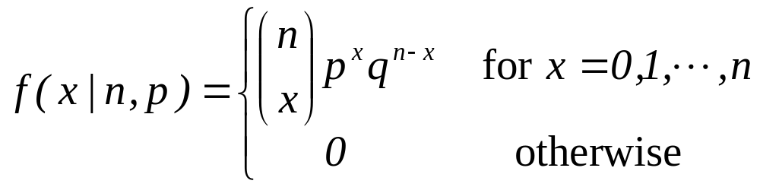
Variance of The Binomial Distribution
If the random variables X1,...,Xn form n Bernoulli trials with parameter p, and if X= X1+…+Xn, then X has a Binomial distribution with parameters n and p.
The p.f. for a random variable having binomial distribution with parameters n and p is
E(X)=np
Var(X)=npq

Slide 15
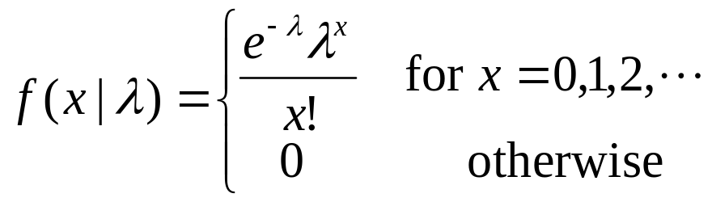
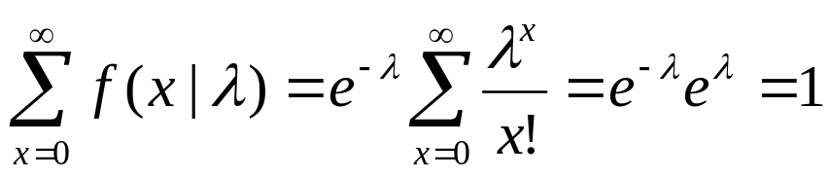
Variance of The Poisson Distribution
A nonnegative random variable X has a Poisson distribution with mean λ (λ>0) if the p.f. of X is as follows:
Note:

Slide 16
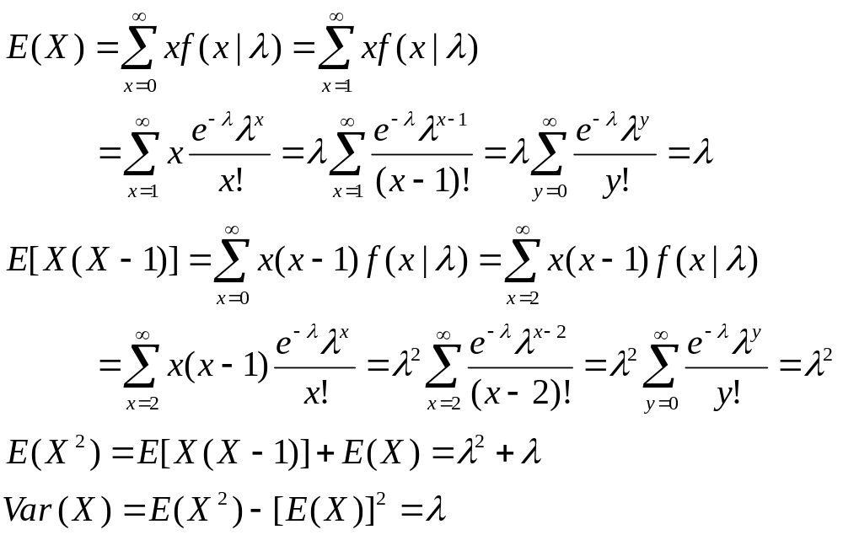
Variance of The Poisson Distribution

Slide 17
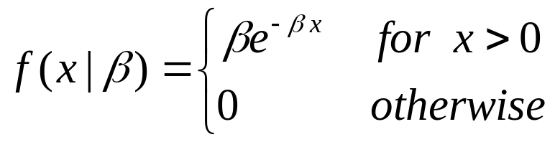
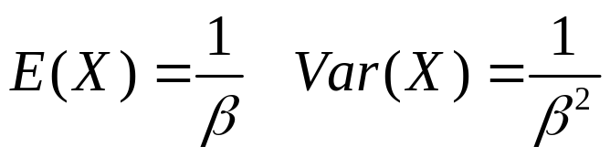
The Exponential Distribution
A random variable X has an exponential distribution with parameter β (β>0) if X has a continuous distribution with p.d.f.

Slide 18
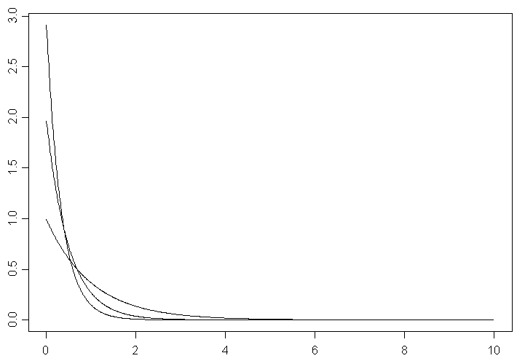



The Rate Parameter β

Slide 19
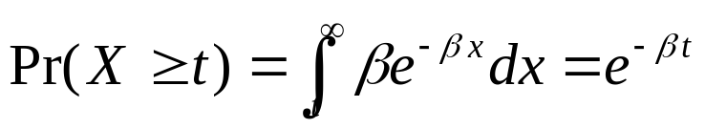
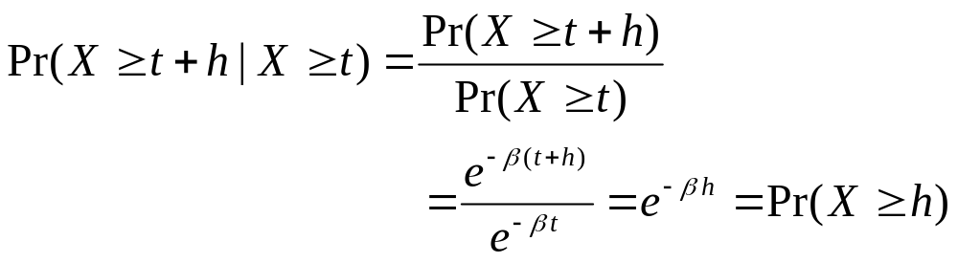
Memoryless Property
If X has an exponential distribution with parameter β, then for any number t>0,
For t>0 and any other number h>0,
  Regardless of the length of time that has elapsed without the occurrence of the event, the probability that the event will occur during the next h minutes always has the same value.

Slide 20
Application ----- Reliability
The exponential distribution is often used in reliability studies as the model for the time until failure of a device.
For example, the lifetime of a semiconductor chip might be modeled as an exponential random variable with a mean of 40,000 hours. The lack of memory property of the exponential distribution implies that the device does not wear out. The lifetime of a device with failures caused by random shocks might be appropriately modeled as an exponential random variable.
However, the lifetime of a device that suffers slow mechanical wear is better modeled by a distribution that does not lack memory.

Slide 21
Life Tests
n light bulbs are burning simultaneously in a test to determine the lengths of their lives. Let Xi denote the lifetime of bulb i, i=1,...,n.
Assume that X1,...,Xn are independent and identically distributed.
Xi has an exponential distribution with parameter β.
What is the distribution of the length of time Y1 until one of the n bulbs fails?

Slide 22
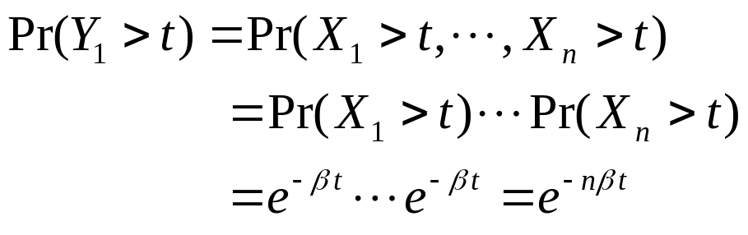
  Y1=min{X1,...,Xn}.
  Theorem 5.9.4. Suppose that the variables X1,...,Xn form a random sample from an exponential distribution with parameter β. Then the distribution of Y1=min{X1,...,Xn} will be an exponential distribution with parameter nβ.
  Proof. For any number t>0,
  The distribution of Y1 must be an exponential distribution with parameter nβ.

Slide 23
What is the distribution of the length of time Y2 after one bulb has failed until a second bulb fails?
  After one bulb has failed, n-1 bulbs remain burning.
  Regardless of the time at which the first bulb failed, the distribution of the remaining lifetime of each of the n-1 bulbs is still an exponential distribution with parameter β.
  Y2 will be equal to the smallest of n-1 i.i.d. random variables, each of which has an exponential distribution with parameter β.
  It follows that Y2 will have an exponential distribution with parameter (n-1)β.

Slide 24
  Similarly, the distribution of the length of time Y3 after two bulbs have failed until a third bulb fails will be an exponential distribution with parameter (n-2)β.
  ...
  After all but one of the bulbs have failed, the distribution of the additional length of time until the final bulb fails will be an exponential distribuition with parameter β.

